Slide 1


A drift robust representation for exploration
Andreas Ziegler
Titus Cieslewski, Davide Scaramuzza
Master Thesis Robotics and Perception Group
Department of Informatics, University of Zurich

Slide 2
Content

Slide 3
How to give a good presentation:
Tell a story!
Motivate the project and define your goal
Explain how others approached this (or a similar) problem
Detail how you approached the problem
Describe your experiments and their outcome
Close the loop with a discussion and an outlook
Discuss your idea with your supervisor before you create the slides
Limit yourself to relevant content!
Omit details unless they are necessary
However: be prepared the explain details in the Q&A session right after the presentation (e.g., have backup slides)
Practice! Practice! Practice!
Present to your supervisors a few days before the actual presentation

Slide 4
How to arrange your slides
Use a few bullet points for each slide. Ideally, no more than 4-5 bullet points for each slide.
Remember that bullet points should be as concise possible (the slides are only meant to support your explanations, not to replace them). For this, each bullet point should not contain more 10 words (exceptions are of course possible).
Each slide should contain a representative picture.
The slides should not look «too messy» or «too crowded». Consider splitting them into multiple slides.
You are allowed to change titles and the order of the slides in this template!

Slide 5
Multimedia
Use figures, images and videos instead of long explanations
Make the pictures and videos as large as you can
In plots and diagrams, make sure all fonts are large enough
Play videos in loops
Play the videos without sound (unless you have good reasons)
Explain briefly what the video will show before you start it
Embed the videos in the presentation

Slide 6
Motivation/Problem Statement
What is exploration?

Slide 7
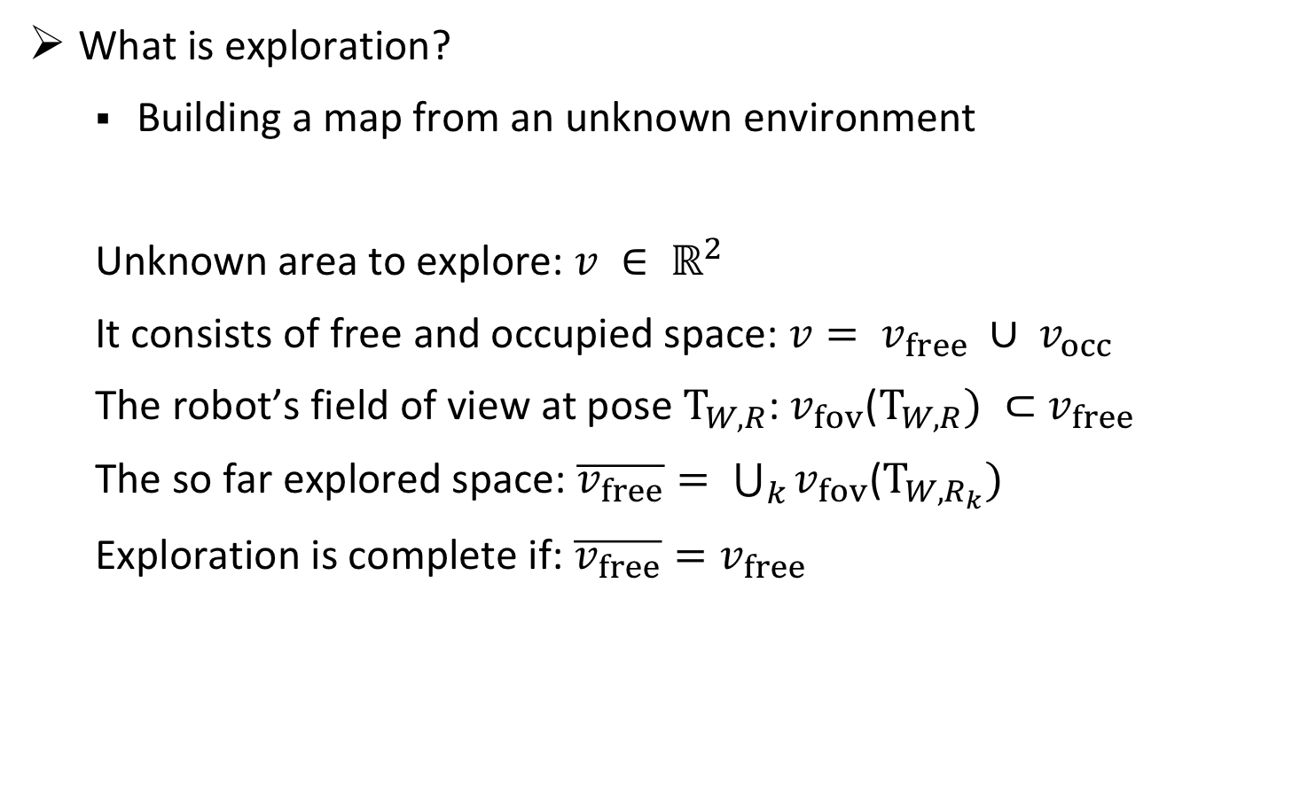
Motivation/Problem Statement
What is exploration?
Building a map from an unknown environment
Unknown area to explore: $v ∈ ℝ^{2}$
It consists of free and occupied space: $v= v_{free} ∪ v_{occ}$
The robot’s field of view at pose $T_{W,R}$: $v_{fov}$($T_{W,R}) ⊂$ $v_{free}$
The so far explored space: $\overline{v_{free}}= \bigcup_{k}{v_{fov}\text{(}T_{W,R_{k}})}$
Exploration is complete if: ${\overline{v_{free}}=v}_{free}$

Slide 8
Motivation/Problem Statement
What is exploration?
Building a map from an unknown environment
How is exploration done?
Mapping the space the robot perceives
Planning where to go next

Slide 9
Motivation/Problem Statement
What is exploration?
Building a map from an unknown environment
How is exploration done?
Mapping the space the robot perceives
Planning where to go next

Slide 10
Motivation/Problem Statement
Most current exploration methods are based on grid-based representations
These representations assume a perfect state estimate
Not realistic for visual(-intertial) odometry

Slide 11
Motivation/Problem Statement
Why is it important to handle drift?

Slide 12
Motivation/Problem Statement
Ground truth trajectory

Slide 13
Motivation/Problem Statement
Ground truth trajectory
Estimated trajectory

Slide 14
Motivation/Problem Statement
Ground truth trajectory
Estimated trajectory
With a grid based representation

Slide 15
Motivation/Problem Statement
Ground truth trajectory
With a grid based representation
What we want

Slide 16
Motivation/Problem Statement
What are the advantage of a representation that can handle drift?
Correct representation of the environment with respect to the trajectory
Map does not need to be rebuilt

Slide 17
Motivation/Problem Statement
Briefly summarize the goal of the project first
What problem are you trying to solve?
Illustrate with pictures, diagrams, videos, formulas, …
Why is it important to solve that problem?
Is it part of a larger project?
What impact might it have on the society, industry, and/or economy
List the challenges

Slide 18
Related Work
Map representations:

Slide 19
Related Work
Map representations:
Metric
Topological
Hybrid

Slide 20
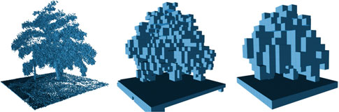
Related Work
Map representations:
Metric
Topological
Hybrid
Figure courtesy: [Hornung, AR 2013]

Slide 21
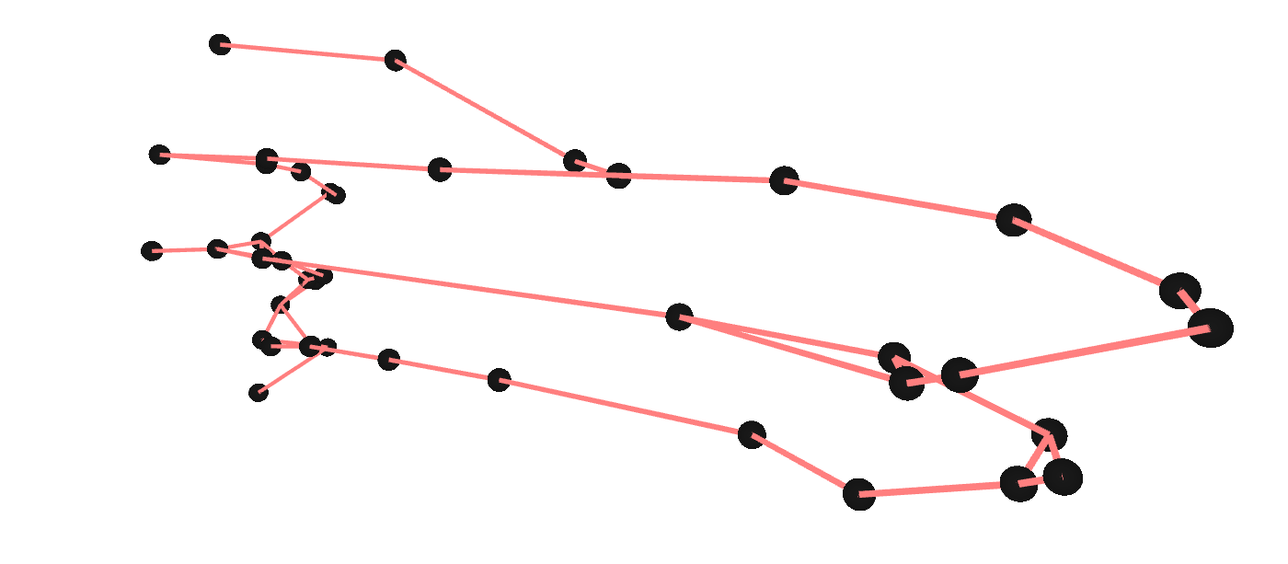
Related Work
Map representations:
Metric
Topological
Hybrid
Figure courtesy: [Blöchliger, arXiv 2017]

Slide 22
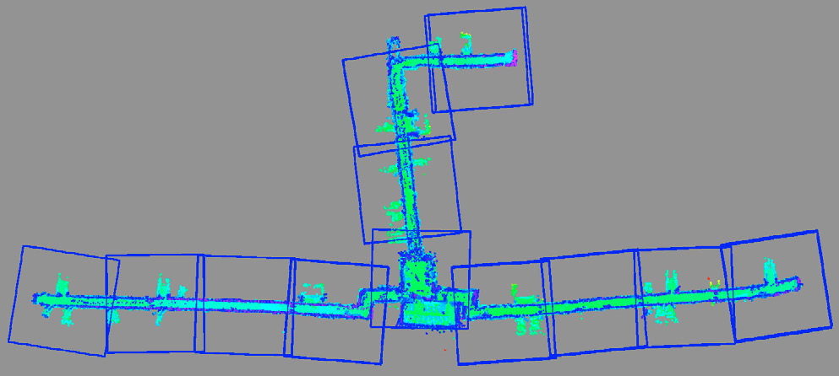
Related Work
Map representations:
Metric
Topological
Hybrid
Figure courtesy: [Schmuck, IFAC 2016]

Slide 23
Related Work
Map representations:
Limitations:
Noisy state estimates (metric representations)
Ground truth trajectory
With a grid metric representation

Slide 24
Related Work
Map representations:
Limitations:
Noisy state estimates (metric representations)
Not enough details for exploration (topological representations)

Slide 25
Related Work
Map representations:
Limitations:
Noisy state estimates (metric representations)
Not enough details for exploration (topological representations)
Needs to rebuilding sub maps in case of a deformation (hybrid representations)

Slide 26
Related Work
Map representations:
Conclusion:
We want a representation that can handle a pose graph exhibiting drift
Ground truth trajectory
What we want

Slide 27
Related Work
Path planning for exploration:
Notes:
In order to understand how to build a good representation, we need to understand how it is used.

Slide 28
Related Work
Path planning for exploration:
Next-best-view (NBV) planner
Frontier-based exploration planner
Notes:
In order to understand how to build a good representation, we need to understand how it is used.

Slide 29
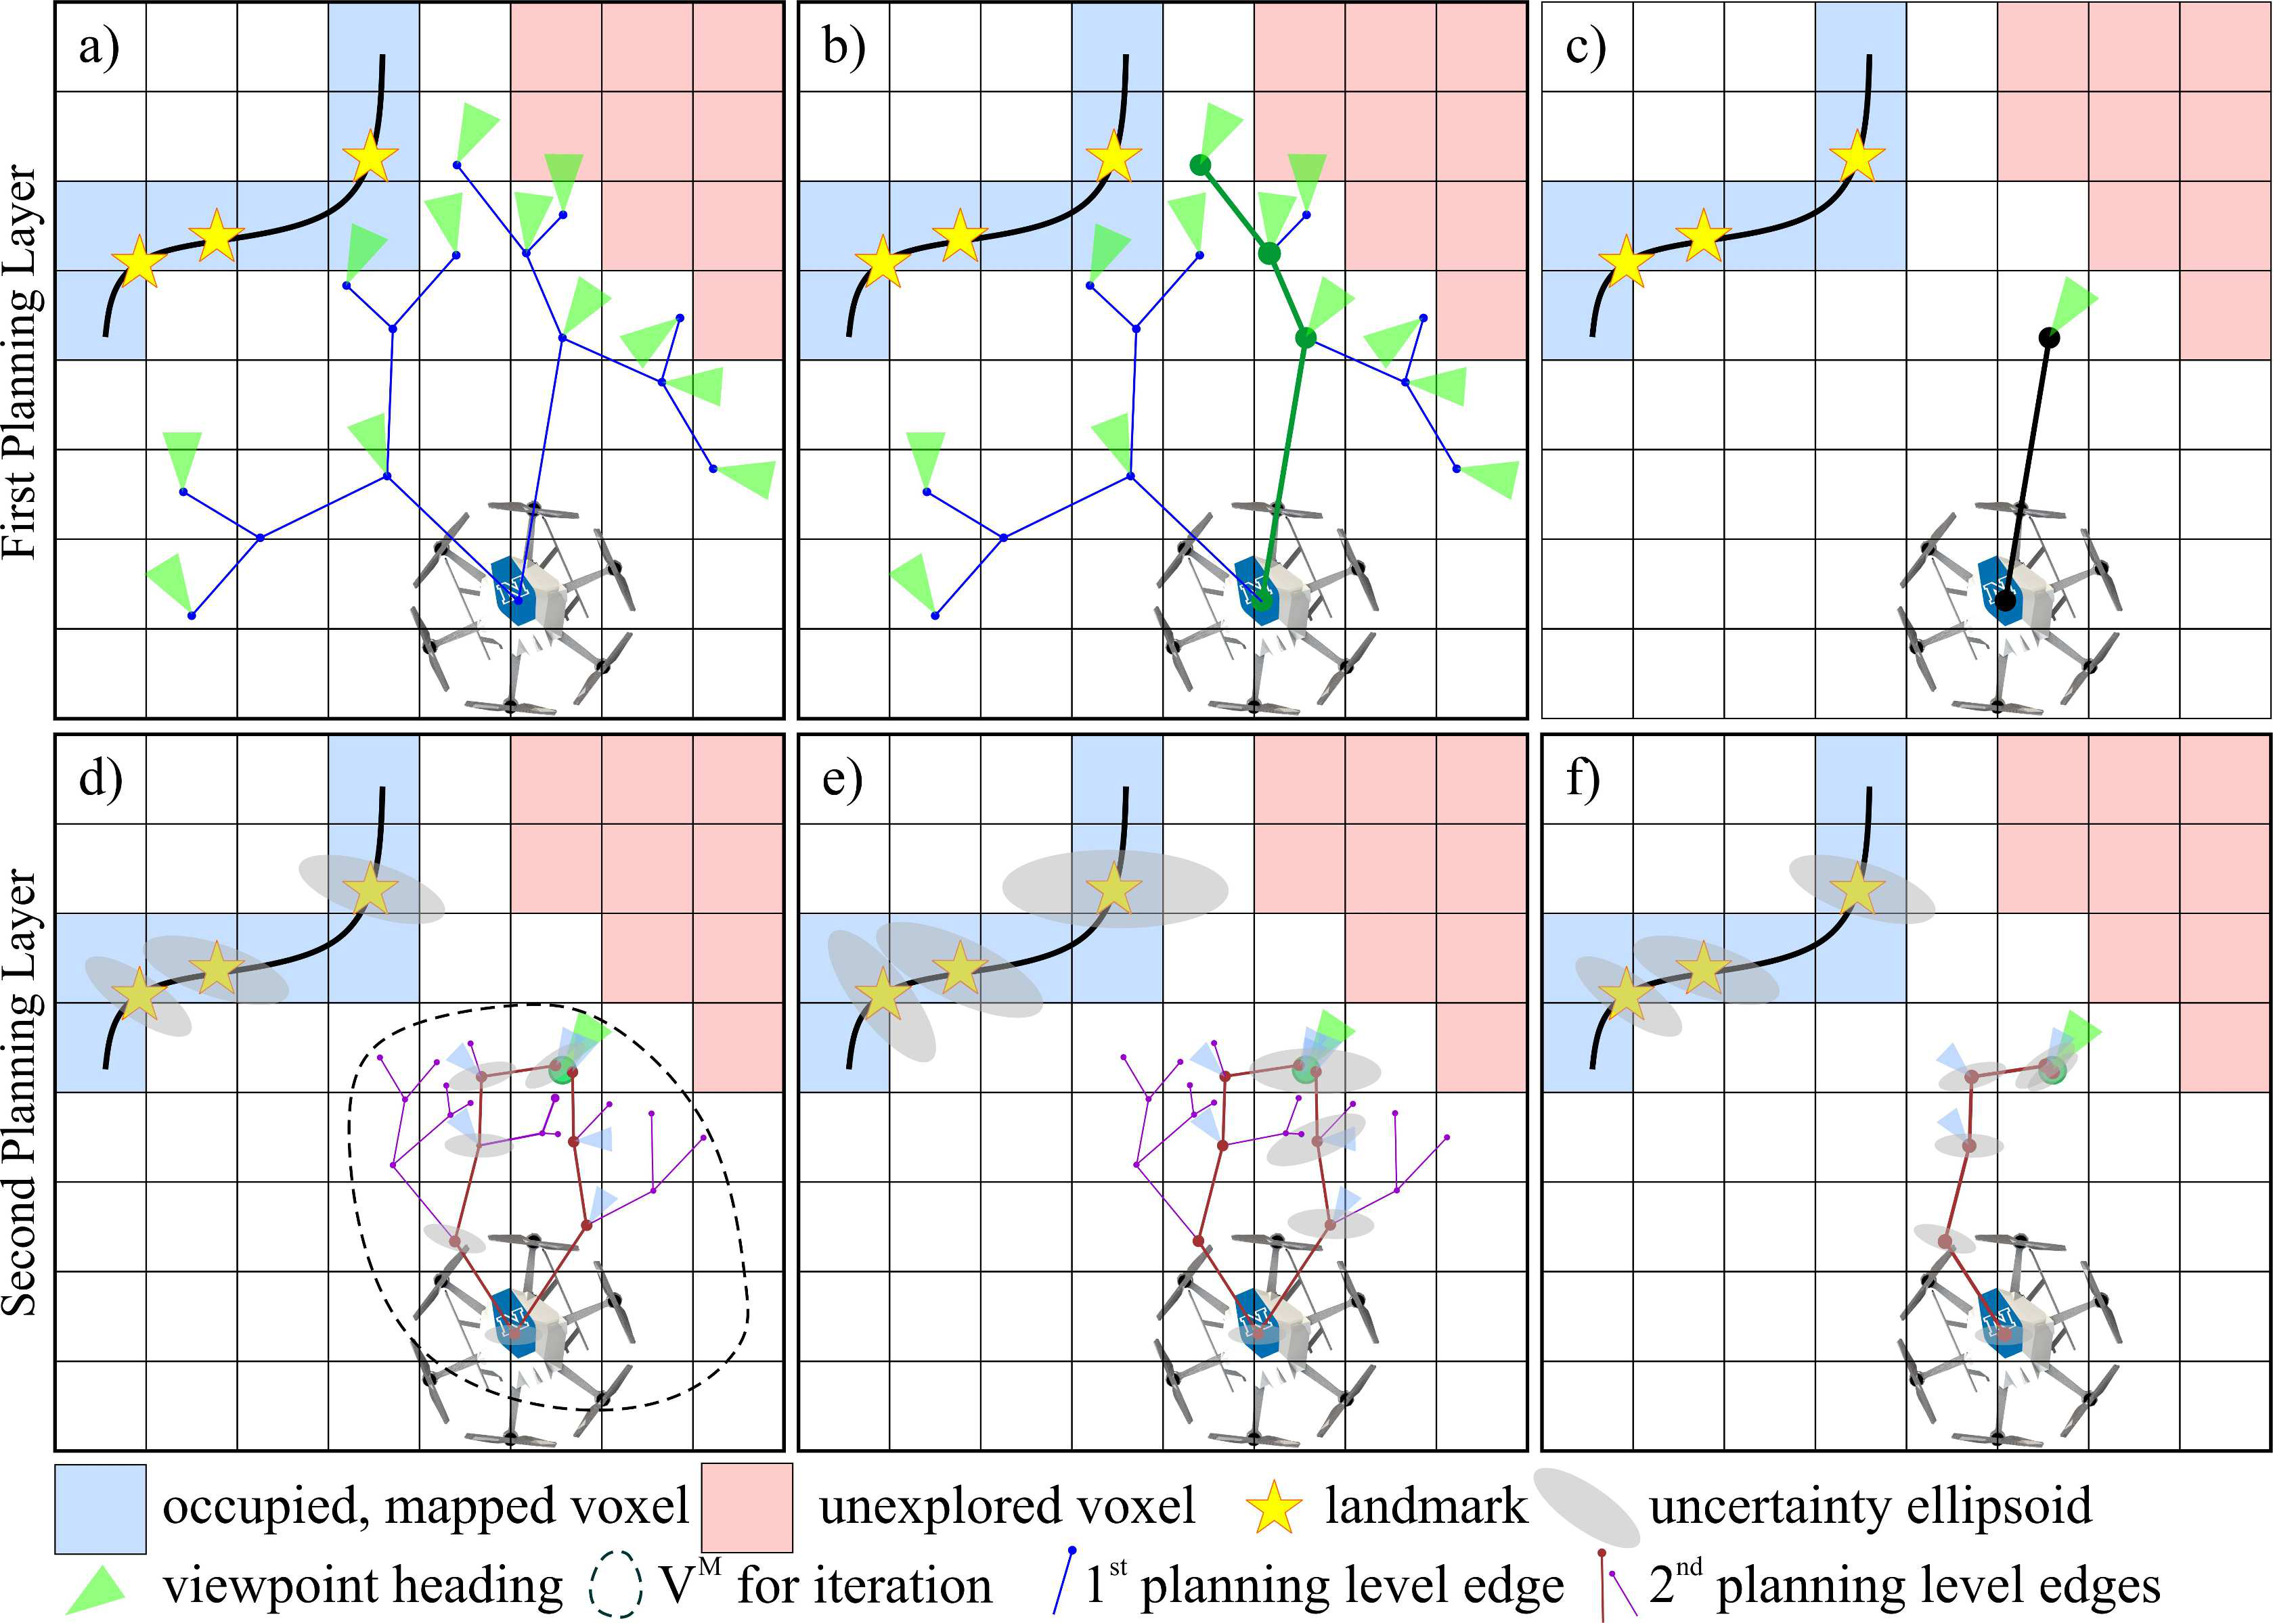
Related Work
Path planning for exploration:
Next-best-view (NBV) planner
Frontier-based exploration planner
Figure courtesy: [Papachristos, ICRA 2017]
Notes:
In order to understand how to build a good representation, we need to understand how it is used.

Slide 30
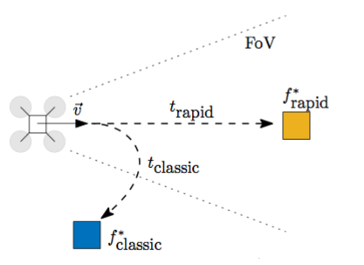
Related Work
Path planning for exploration:
Next-best-view (NBV) planner
Frontier-based exploration planner
Figure courtesy: [Cieslewski, IROS 2017]
Notes:
In order to understand how to build a good representation, we need to understand how it is used.

Slide 31
Related Work (1 or 2 slides)
What has already been done in previous research
Cite previous works with last name of the first author, journal/conference abbreviation, and year of publication, e.g., [Faessler, JFR 2015] or [Forster, ICRA 2014]
It often helps to use a representative figure from that paper
You may also cite newspaper articles or websites
In what is your work different from previous work?
Hint: Add pictures/videos of previous work

Slide 32
Approach - Key properties
Key properties our representation has to satisfy:
Robustness to drift
Deformable
Frontier-based

Slide 33
Approach - Polygon based representation
Polygons can represent environments at any degree of precision
Represent the boundary between known and unknown space
Deformable
Frontier-based
Notes:
Our approaches are based on polygons

Slide 34
Approach - Polygon from depth measurements
RGBD camera as source to build the polygon of the field of view
Take position of the depth measurements as vertices
Take robot’s position as first (and last) vertex
Notes:
Our approaches are based on polygons

Slide 35
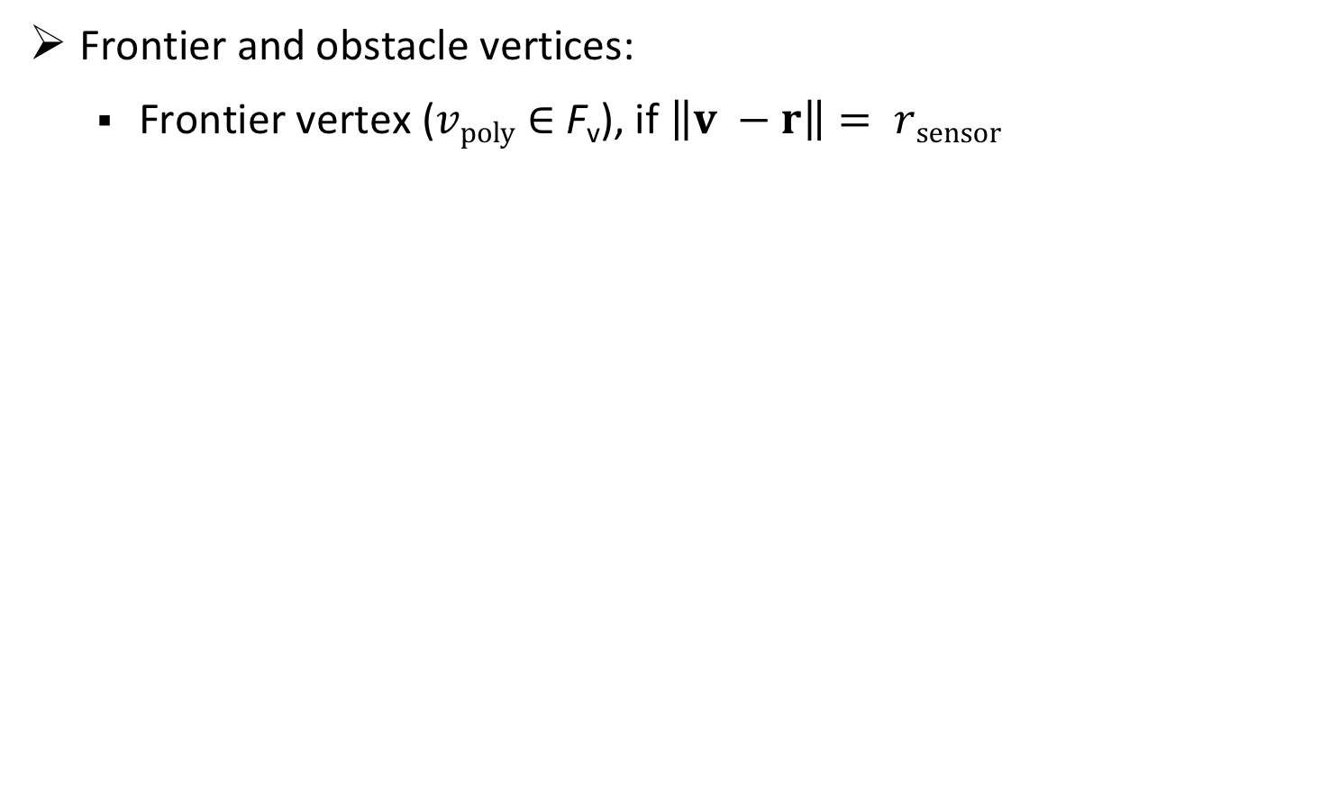
Approach - Polygon from depth measurements
Frontier and obstacle vertices:
Frontier vertex ($vpoly∈$ F_{v}), if $\left\|v −r\right\|= rsensor$
v
r
Notes:
Our approaches are based on polygons

Slide 36
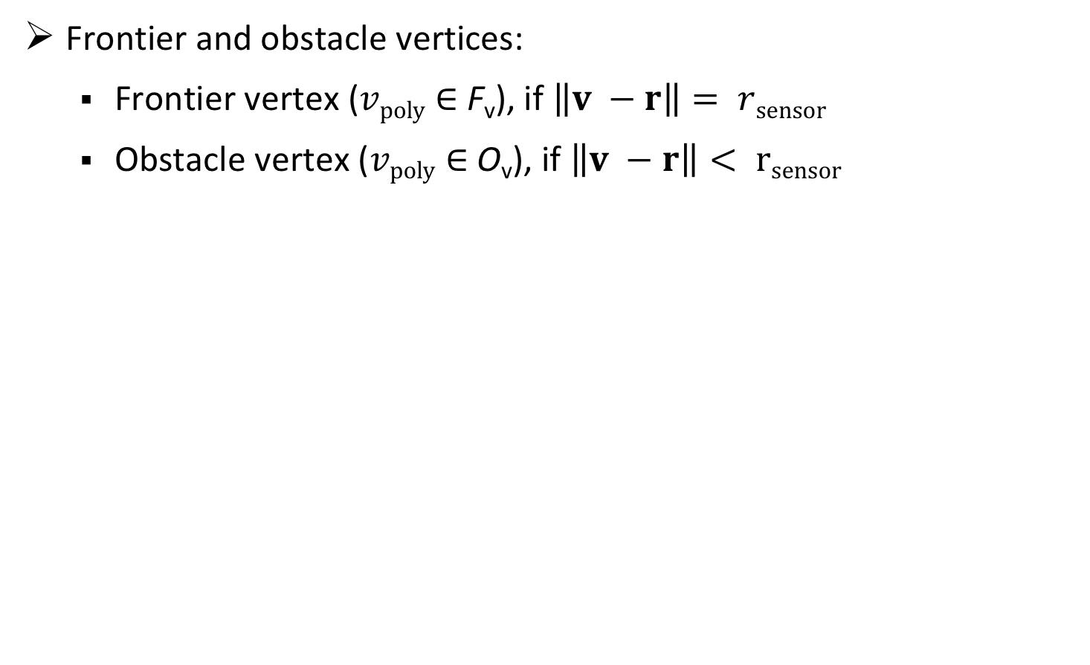
Approach - Polygon from depth measurements
Frontier and obstacle vertices:
Frontier vertex ($vpoly∈$ F_{v}), if $\left\|v −r\right\|= rsensor$
Obstacle vertex ($vpoly∈$ O_{v}), if $\left\|v −r\right\|< rsensor$
v
r
Notes:
Our approaches are based on polygons

Slide 37
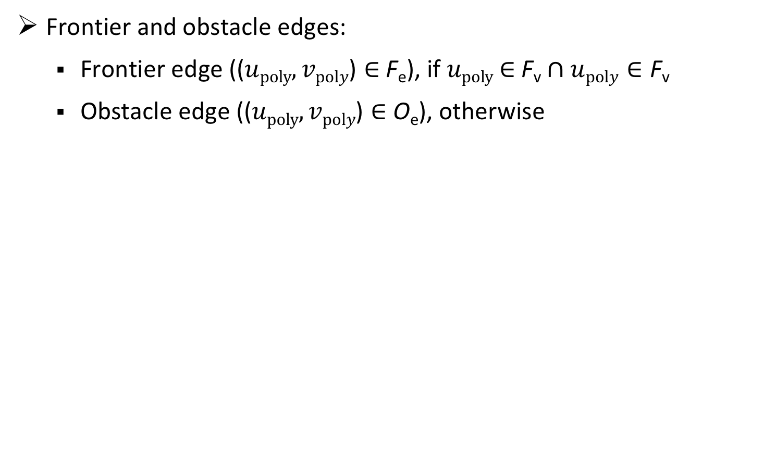
Approach - Polygon from depth measurements
Frontier and obstacle edges:
Frontier edge (($upoly,vpoly\text{)}∈$ F_{e}), if $upoly$ $∈$ F_{v}$∩upoly∈\text{F}\text{v}$
Obstacle edge (($upoly,vpoly\text{)}∈$ O_{e}), otherwise
Notes:
Our approaches are based on polygons

Slide 38
Approach - Polygon from depth measurements
Frontier and obstacle edges:
Frontier edge (($upoly,vpoly\text{)}∈$ F_{e}), if $upoly$ $∈$ F_{v}$∩upoly∈\text{F}\text{v}$
Obstacle edge (($upoly,vpoly\text{)}∈$ O_{e}), otherwise
Notes:
Our approaches are based on polygons

Slide 39
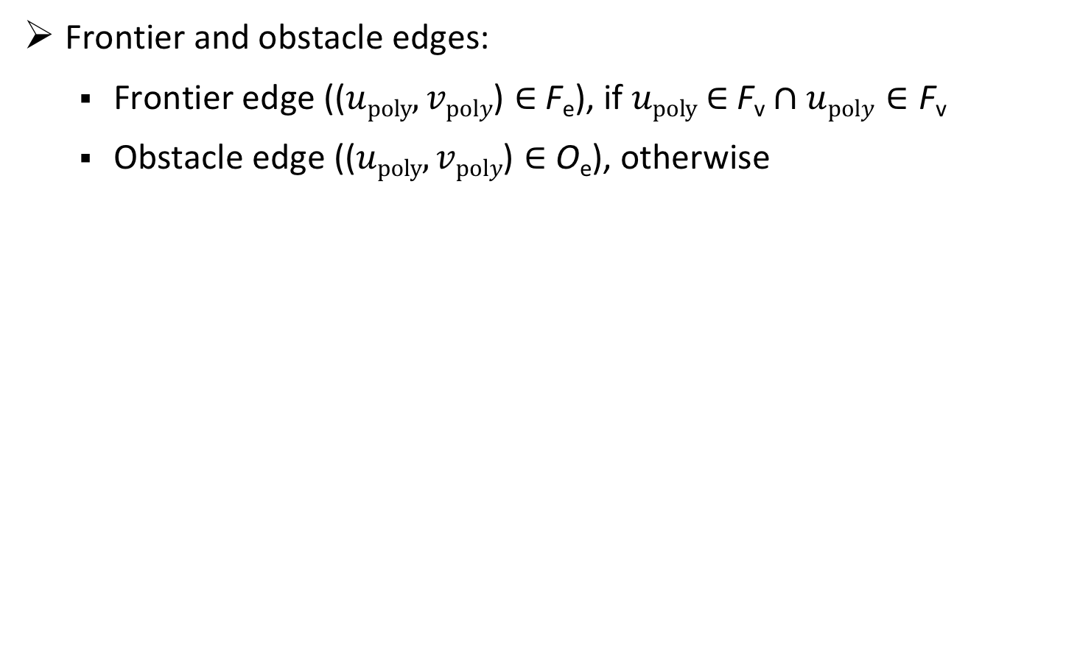
Approach - Polygon from depth measurements
Frontier and obstacle edges:
Frontier edge (($upoly,vpoly\text{)}∈$ F_{e}), if $upoly$ $∈$ F_{v}$∩upoly∈\text{F}\text{v}$
Obstacle edge (($upoly,vpoly\text{)}∈$ O_{e}), otherwise
Notes:
Our approaches are based on polygons

Slide 40
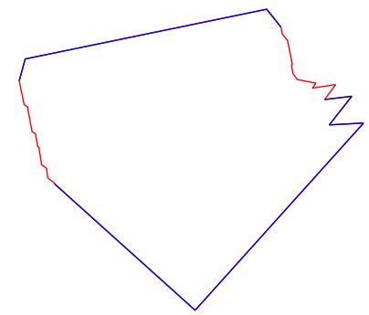

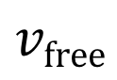
Approach - Polygon based representation
An example of a polygon:
$$vfree$$
$$∂vfree$$
Notes:
Our approaches are based on polygons

Slide 41
Approach - Polygon based representation
Polygon union:
Searching intersections
Merging the line segments
Notes:
Our approaches are based on polygons

Slide 42
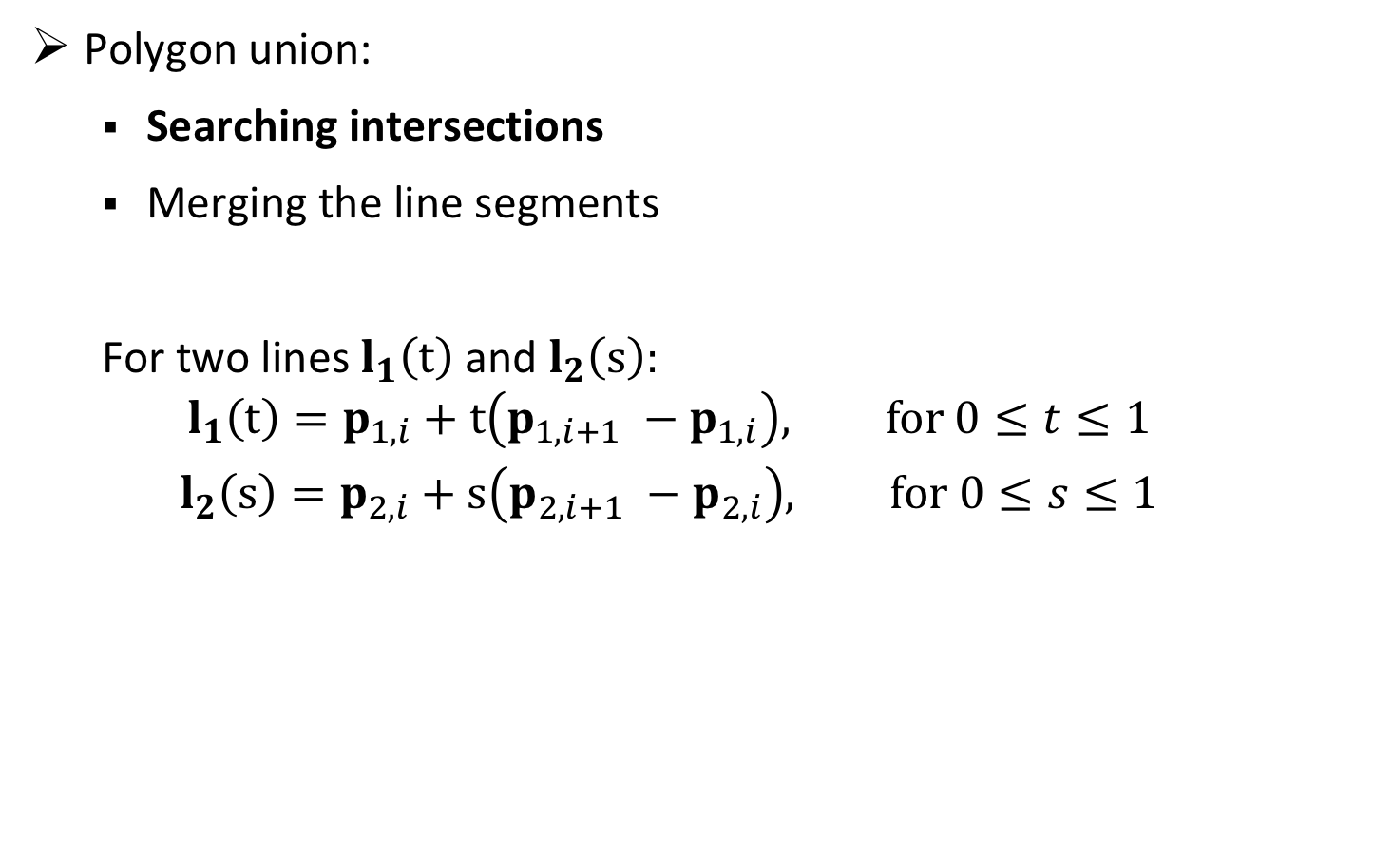
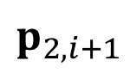
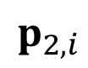
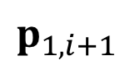
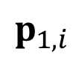
Approach - Polygon based representation
$$p_{2,i+1}$$
Polygon union:
Searching intersections
Merging the line segments
For two lines $l_{1}\left(t\right)$ and $l_{2}\left(s\right):$ $$l_{1}\left(t\right)=p_{1,i}+t\left(p_{1,i+1} −p_{1,i}\right), for 0≤t≤1$$
$$l_{2}\left(s\right)=p_{2,i}+s\left(p_{2,i+1} −p_{2,i}\right), for 0≤s≤1$$
$$p_{1,i+1}$$
$$p_{1,i}$$
$$p_{2,i}$$
Notes:
Our approaches are based on polygons

Slide 43
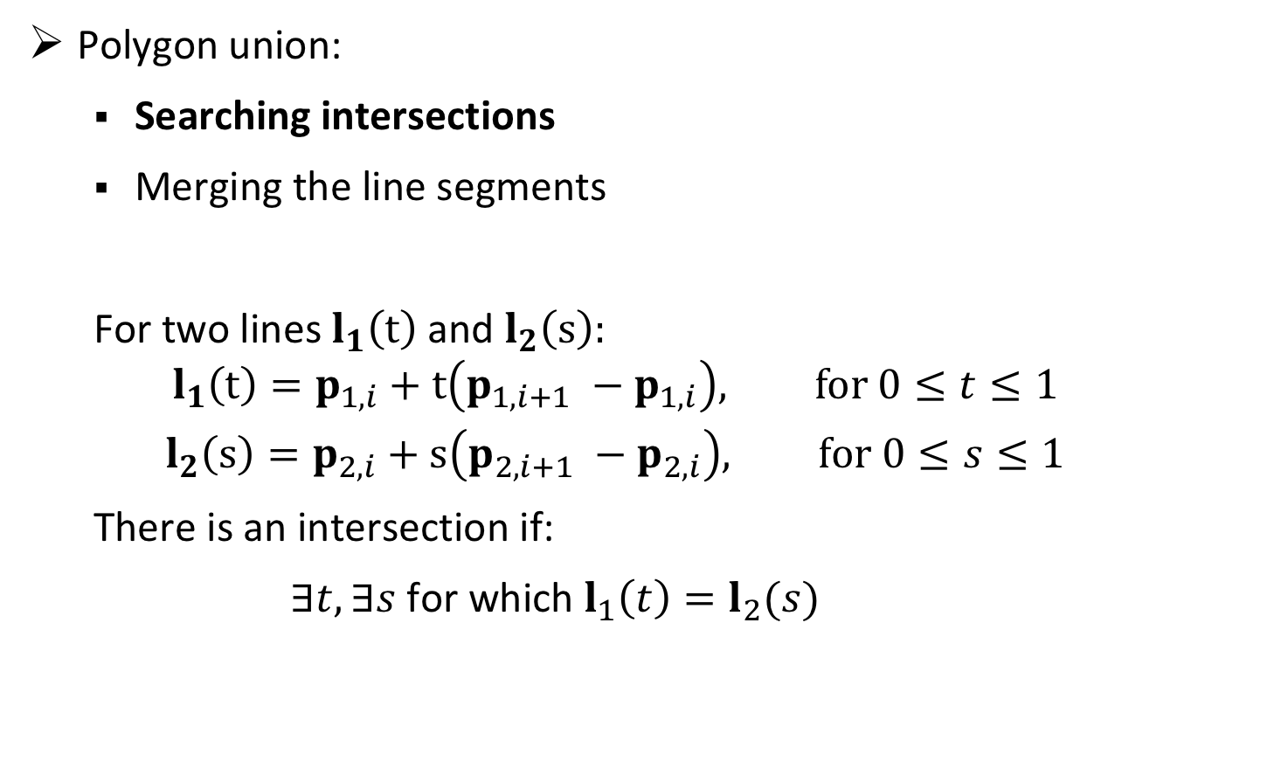
Approach - Polygon based representation
$$p_{2,i+1}$$
Polygon union:
Searching intersections
Merging the line segments
For two lines $l_{1}\left(t\right)$ and $l_{2}\left(s\right):$ $$l_{1}\left(t\right)=p_{1,i}+t\left(p_{1,i+1} −p_{1,i}\right), for 0≤t≤1$$
$$l_{2}\left(s\right)=p_{2,i}+s\left(p_{2,i+1} −p_{2,i}\right), for 0≤s≤1$$
There is an intersection if:
$∃t, ∃s$ for which $l_{1}\left(t\right)=l_{2}(s)$
$$p_{1,i+1}$$
$$p_{1,i}$$
$$p_{2,i}$$
Notes:
Our approaches are based on polygons

Slide 44
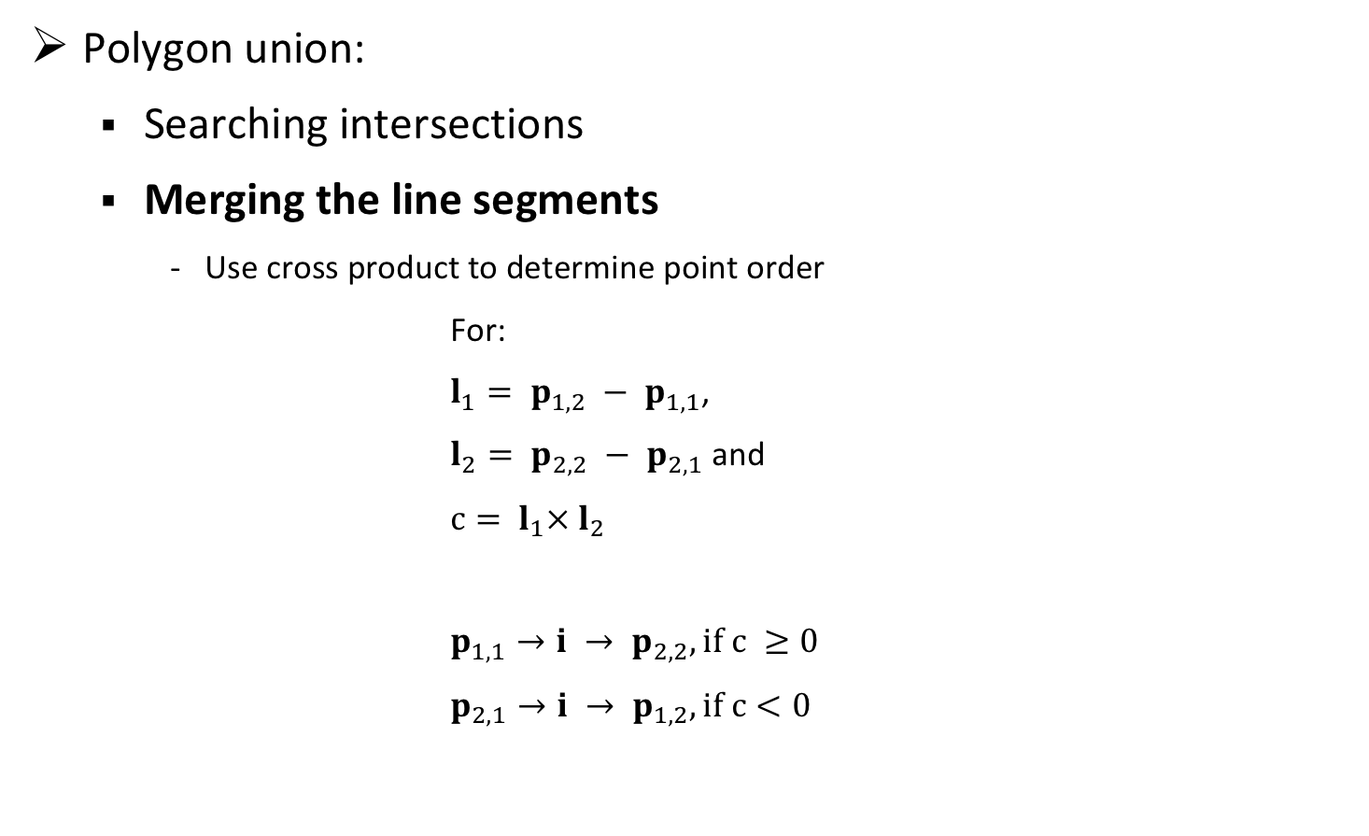
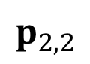
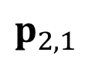
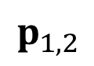
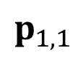
Approach - Polygon based representation
$$p_{2,2}$$
Polygon union:
Searching intersections
Merging the line segments
Use cross product to determine point order
For:
$l_{1}= p_{1,2} − p_{1,1}$,
$l_{2}= p_{2,2} − p_{2,1}$ and
$c= l_{1}× l_{2}$
$p_{1,1}→i → p_{2,2}, if c ≥0$
$p_{2,1}→i → p_{1,2}, if c<0$
$$p_{1,2}$$
i
$$p_{1,1}$$
$$p_{2,1}$$
Notes:
Our approaches are based on polygons

Slide 45
Approach - Polygon based representation
Polygon union:
Searching intersections
Merging the line segments
Notes:
Our approaches are based on polygons

Slide 46
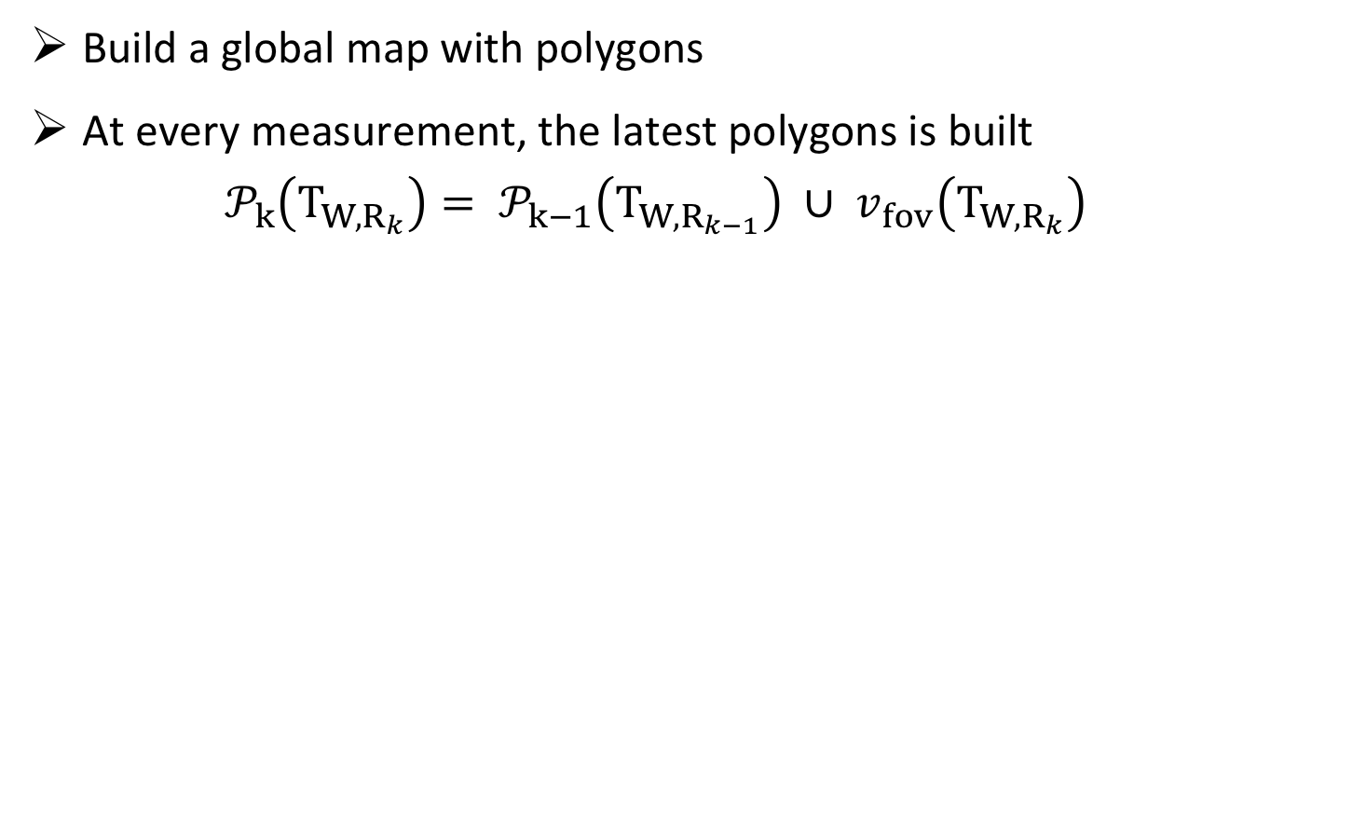
Approach - Polygon based representation
Build a global map with polygons
At every measurement, the latest polygons is built
$$𝒫_{k}\left(T_{W,R_{k}}\right)= 𝒫_{k−1}\left(T_{W,R_{k−1}}\right) ∪ v_{fov}\left(T_{W,R_{k}}\right)$$

Slide 47
Approach - Key properties
Robustness to drift
Deformable
Frontier-based

Slide 48

Approach - Key properties
Robustness to drift
Deformable
Frontier-based

Slide 49
Approach - Key properties
Robustness to drift
Deformable:
Every polygon vertex is associated to a pose graph vertex
Allows to modify the polygon according to the pose graph
Frontier-based

Slide 50
Approach - Key properties
Robustness to drift
Deformable
Frontier-based

Slide 51
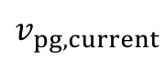
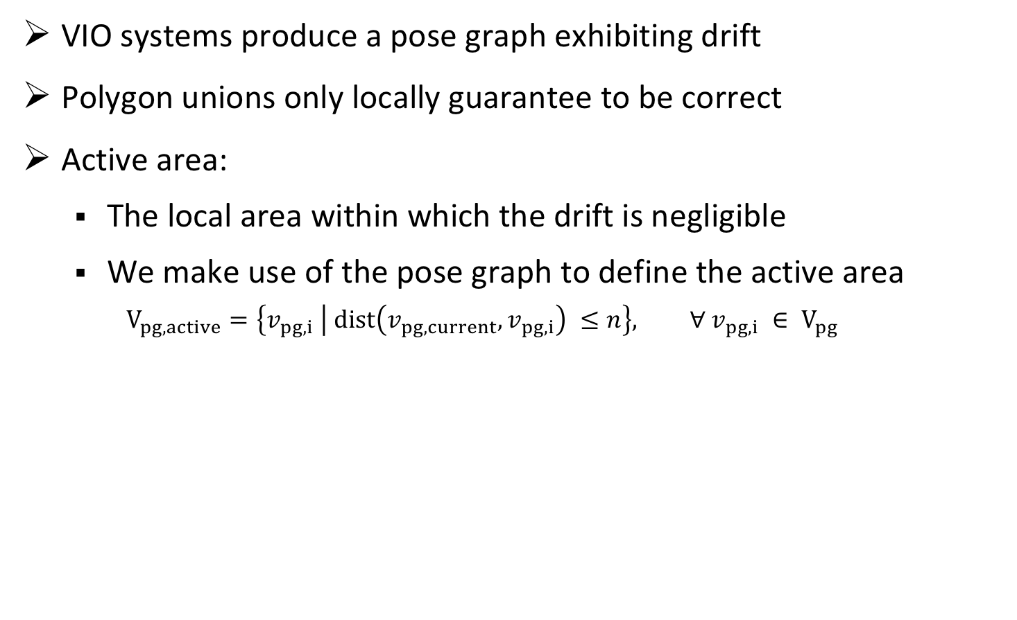
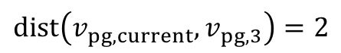
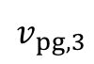
Approach - Robustness to drift
VIO systems produce a pose graph exhibiting drift
Polygon unions only locally guarantee to be correct
Active area:
The local area within which the drift is negligible
We make use of the pose graph to define the active area
$$V_{pg,active}=\left\{v_{pg,i} | dist\left(v_{pg,current}, v_{pg,i}\right) ≤n\right\}, ∀ v_{pg,i} ∈ V_{pg}$$
$$v_{pg,3}$$
$$v_{pg,current}$$
$$dist\left(v_{pg,current}, v_{pg,3}\right)=2$$

Slide 52
Approach - Robustness to drift
VIO systems produce a pose graph exhibiting drift
Polygon unions only locally guarantee to be correct
Active area:
The local area within which the drift is negligible
We make use of the pose graph to define the active area
All the polygon vertices belonging to a pose graph vertex in the active area

Slide 53
Approach - Robustness to drift
VIO systems produce a pose graph exhibiting drift
Polygon unions only locally guarantee to be correct
Active area:
The local area within which the drift is negligible
We make use of the pose graph to define the active area
All the polygon vertices belonging to a pose graph vertex in the active area
How to merge if it should actually overlap?

Slide 54
Approach - How to merge if it should actually overlap?
Merge polygons if SLAM system detected a loop closure:
Correct polygons according to the corrected pose graph
Merge polygons

Slide 55
Approach - Key properties
Robustness to drift
Deformable
Frontier-based

Slide 56

Approach

Slide 57
Approach - Limitations of the first approach
The problem of desired and undesired self intersections:
Self intersections can occur:
After the correction of the polygons

Slide 58
Approach - Limitations of the first approach
The problem of desired and undesired self intersections:
Self intersections can occur:
After the correction of the polygons (undesired)
Due to a union with the field of view before a loop closure (desired)

Slide 59
Approach - Limitations of the first approach
The problem of desired and undesired self intersections:
Self intersections can occur:
After the correction of the polygons
Due to a union with the field of view before a loop closure
We did not find a general way to distinguish wanted and not wanted self intersections, only some heuristics

Slide 60
Approach - Limitations of the first approach
The problem of the size of the active area:
Fixing self intersections in the active area

Slide 61
Approach - Limitations of the first approach
The problem of the size of the active area:
Fixing self intersections in the active area

Slide 62
Approach - Limitations of the first approach
The problem of the size of the active area:
Fixing self intersections in the active area
A solution would be to increase the size of the active area

Slide 63
Approach - Limitations of the first approach
The problem of the size of the active area:
A too big active area with small obstacles

Slide 64
Approach - Limitations of the first approach
The problem of desired and undesired self intersections
The problem of the size of the active area
These limitations lead as to a new approach

Slide 65
Approach - Local polygons
The limitations of the first approach due to building a global map
A global map is not required for frontier-based exploration
We need to know where there are frontiers
We need to know how to go there
The pose graph and local polygons with frontier, obstacle and free space edges is all we need

Slide 66
Approach - Local polygons
Determine polygon edges type:
Determine intersecting polygons

Slide 67
Approach - Local polygons
Determine polygon edges type:
Determine intersecting polygons
Resolving overlaps with the intersecting polygons

Slide 68
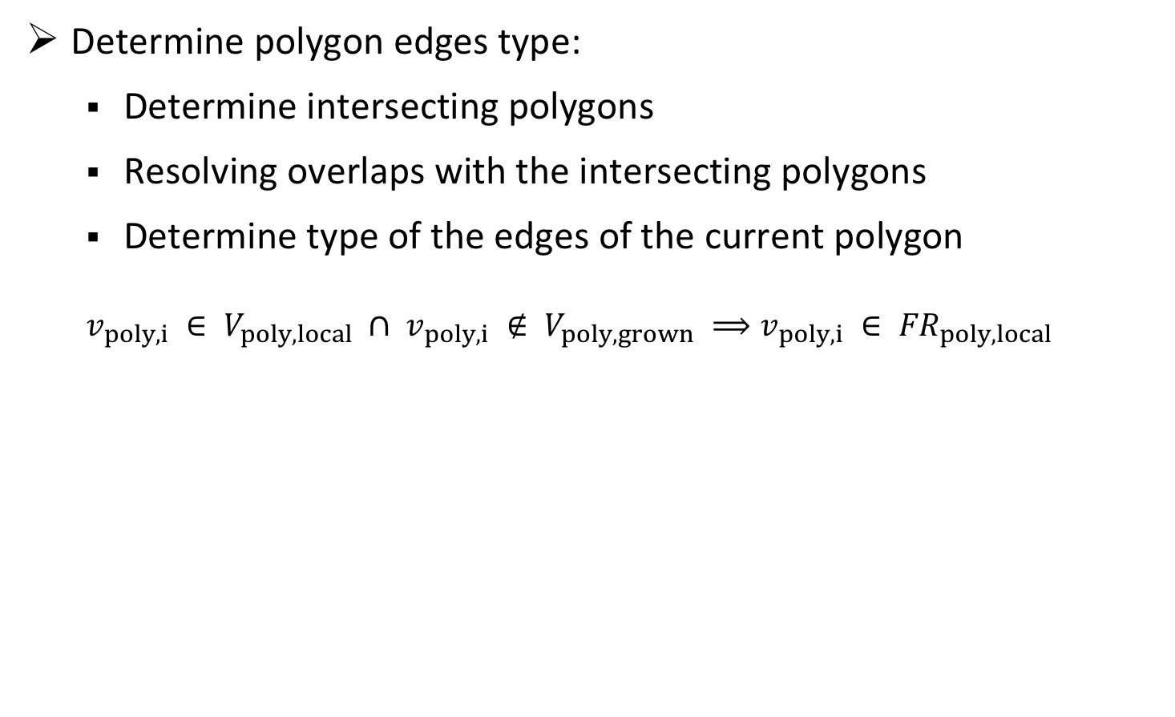
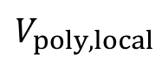
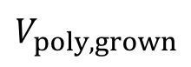
Approach - Local polygons
Determine polygon edges type:
Determine intersecting polygons
Resolving overlaps with the intersecting polygons
Determine type of the edges of the current polygon
$$v_{poly,i} ∈ V_{poly,local} ∩ v_{poly,i} ∉ V_{poly,grown} ⟹v_{poly,i} ∈ {FR}_{poly,local}$$
$$V_{poly,local}$$
$$V_{poly,grown}$$

Slide 69
Approach (up to 5 slides)
How did you approach the problem?
Did you decompose the problems in smaller problems?
If so, how did you approach each of them?
List the assumptions you made and the resulting limitations
Hint: Add figures, pictures, or videos

Slide 70
Experimental Setup
We built an own simulation environment
Basic loop closure functionality
Basic localization functionality
Simulation of a robot (3 DoF) moving in 2D maps
Written in python with matplotlib and numpy
Sensor noise is simulated

Slide 71
Experimental Setup
Evaluation of the representation approach:
We run the same exploration also with a grid based representation
We determine ground truth (free and occupied cells) from the map
At the end of the exploration we compare the explored cells with the ground truth
We compare the time the exploration takes with both representations

Slide 72
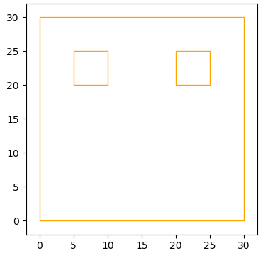
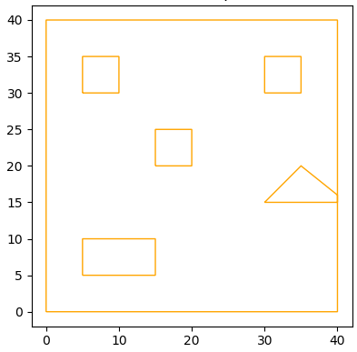
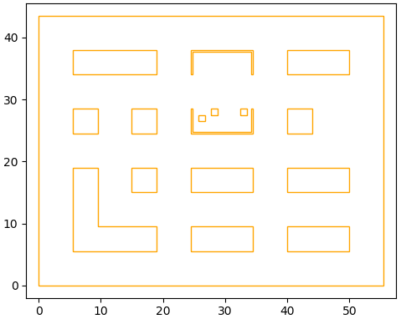
Experimental Setup
Simulated maps

Slide 73
Experimental Setup (1 or 2 slides)
Simulated and/or real experiments?
What platforms (e.g., robots) did you use in the simulated and or real experiments?
What pre-existing libraries did you use? Did you make your own?
What are the assumptions in each experiments? (e.g., noise free, motion-capture system, planar motion, etc.)
Mandatory: Add pictures and/or videos of your experimental setup

Slide 74
Results (up to 5 slides)
List all relevant experimental results (both simulated and real)
Show plots for each approach
Add legends and units, use large enough fonts!
If you have simulations, make sure you show them in the noise-free case and with increasing noise
Comment about each plot:
What does the plot visualize (what are the axes)?
What conclusions can we draw from the data?
Comment on peculiarities:
E.g., glitches on a plot, why?
E.g., the trend of the plot is linear or parabolic, why?
Mandatory: Add plots/pictures/videos of your experiments!

Slide 75
Results (up to 5 slides)
List all relevant experimental results (both simulated and real)
Show plots for each approach
Add legends and units, use large enough fonts!
If you have simulations, make sure you show them in the noise-free case and with increasing noise
Comment about each plot:
What does the plot visualize (what are the axes)?
What conclusions can we draw from the data?
Comment on peculiarities:
E.g., glitches on a plot, why?
E.g., the trend of the plot is linear or parabolic, why?
Mandatory: Add plots/pictures/videos of your experiments!

Slide 76
Discussion (1 or 2 slides)
Discuss your project: compare your results with the goal you presented in the beginning of the presentation
If your project is part of a larger project, which parts did you solve, which are still open?
List your achievements!
List the limitations of your approach/implementation (all systems have simitations!)
When does it work?
When does it fail?
Failure is part of the game: do not be afraid to list them!
If it does not work, what could be the reasons?

Slide 77
Outlook (1 slide)
What are possible extensions of your project?
What is the lesson learned?
What could be a different approach?
Be concise here!

